Slide 1
Statistics Canada - LODE and COVID-19 Visualization
Shreeram Murali, Sofia Bahmutsky, Ngan Lyle, Kaitlyn Hobbs

Slide 2

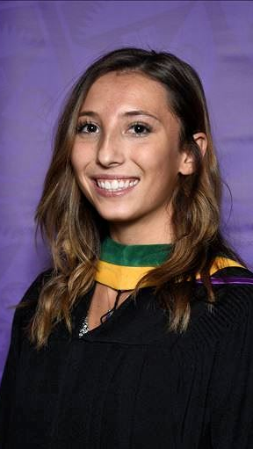
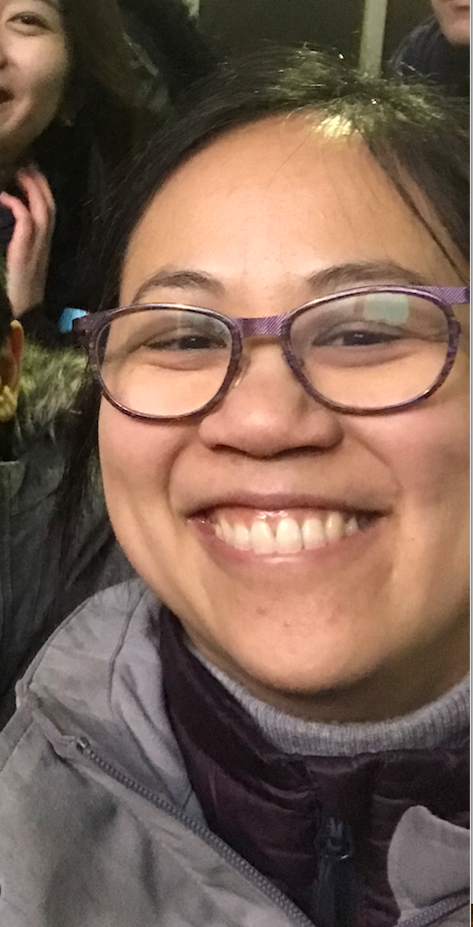

Team Introduction
Sofia KT Ngan Shreeram

Slide 3

Summary of Client
Contacts: Bruno St-Aubin, Marian Radulescu
Aims:
(1) Assess the quality and possible improvement of our open data sources.
(2) Build a product that shows that the open data sources we’ve produced are useable in complex analytical cases.
Notes:
Bruan and Marian from the research lab at Statistics Canada came to us with two goals:

Slide 4
Introduction
Coronavirus/COVID-19 Pandemic
First appeared in China December 31, 2019
Rapid spread
> 180 countries
> 3 million cases
> 230,000 deaths
In Canada
Almost 60,000 confirmed cases
Almost half of deaths in seniors living in long term care facilities

Slide 5
Data
Ontario provincial health COVID data - .CSV
Open Database for Health Facilities (ODHF) data - .CSV
Open Database of Buildings (ODB) data for Ontario - Spatial files
Potentially, Proximity Data for transit, health care, pharmacies.

Slide 6
Project Aims
Deliver completed and cleaned ODB dataset, focus on healthcare facilities and potentially other facility types as needed and time allowing (ex. meat processing plants). Completed using R or Python, depending on Statistics Canada preference.
Deliver visualizations for healthcare facilities and proximity metrics.
Produce a research paper including exploratory analysis of patterns and/or connection between ODB, ODHF, proximity data, and COVID-19 data.

Slide 7
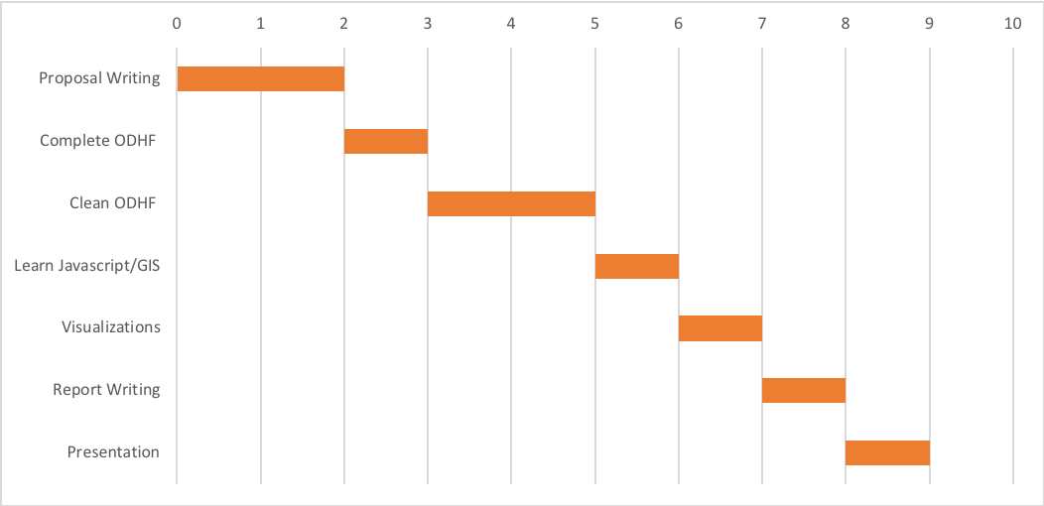
Project Overview
https://trello.com/b/BOM8D6zv

Slide 8
Week 1: Summary of Individual and Team Work Logs
1. Wednesday April 29 we had a virtual meeting with our capstone partners, Bruno St-Aubin and Marian Radulescu from Statistics Canada. The general idea of the project was introduced to us.
2. We worked together on the proposal, which we will send as a draft to our capstone partners on Tuesday May 5, so they will have time to review and provide us with feedback. We can make required edits for the final draft of the proposal after our next virtual meeting with our partners on May 6.
3. We worked together to create presentation slides for Tuesday May 5 presentation to Dr. Scott Fazackerley and TA's.
4. Individually, we each did personal research to get more background information about COVID-19 situation in Canada, especially Ontario.

Slide 9
Potential Limitations
Requested by client to use GIS and JavaScript for D3 visualizations provide a learning curve.
Ensuring data and visualizations update live.

Slide 10
Next Week’s Agenda
Shreeram & Kaitlyn - Web Scraping outbreaks in Ontario long-term care facilities and cross referencing with ODHF.
Ngan & Sofia - Integration of OpenStreetmap data to complete missing addresses of ODHF.

